Slide 1
FONTYS UNIVERSITY OF APPLIED SCIENCE DEPARTMENT OF ICT & SOFTWARE
PRO CP-FINAL PRESENTATION
CAR TRAFFIC SIMULATION
June 12th 2019
Team members
Aktar, Dohlon 3047040
Alex Kersjes 3361616
Gang Ferdinand Dinga 3216861
Fahim 2936968
Alessandro Sandor 2879964

Slide 2
Overview
Problem statement
Project goal
Project deliverables
Our Process
Reflection (Our opinion about our result)
The ups and downs of our project
Demo application
Conclusion.

Slide 3
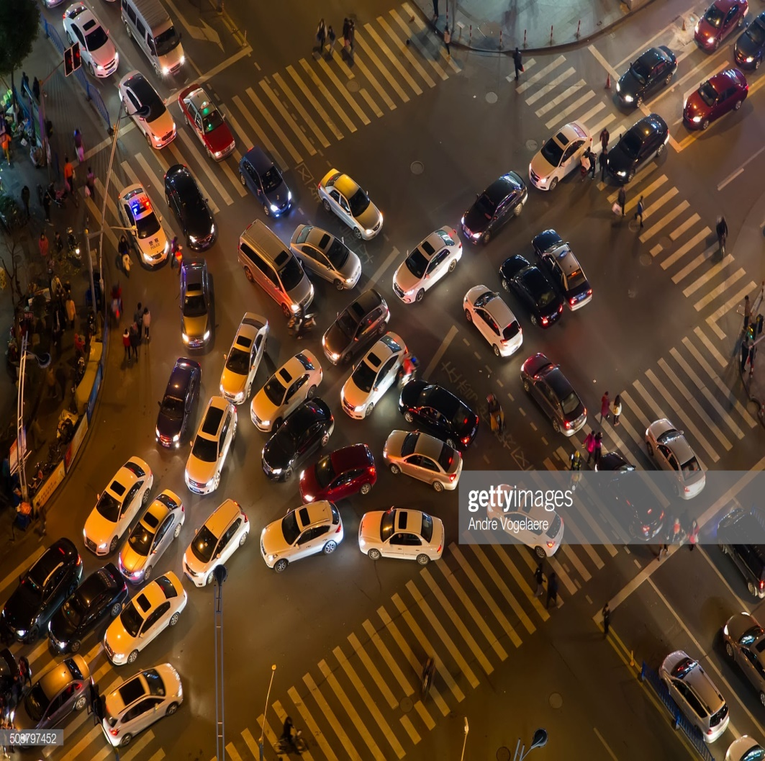

Problem statement

Slide 4
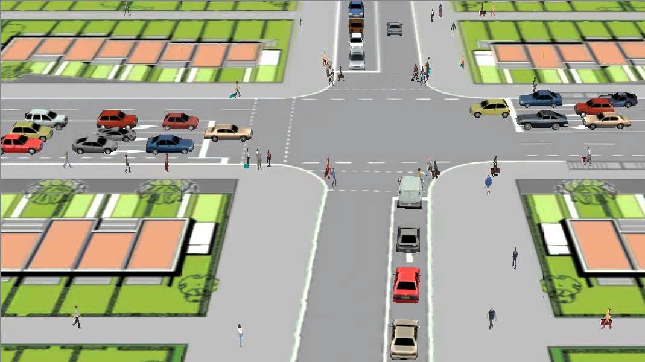
Project goal
Create a software solution package that should
Simulate traffic and pedestrian flow.
Optimize the configuration of roads, crossings and traffic lights via statistics related to how the traffic jam can be resolve.
The primary use of the application is for testing different strategies for traffic light.

Slide 5
Project deliverables At the end of this project we delivered:
1) A working application
(simulation software) in accordance with the
project goals
Source codes for the application.
2) Documents that contains information about the the
application.
Design document
URS
Process report

Slide 6
Our Process
Design phase: Brain storming
Iteration one: core framework made
Iteration two: user interface focus
Iteration three: building features

Slide 7
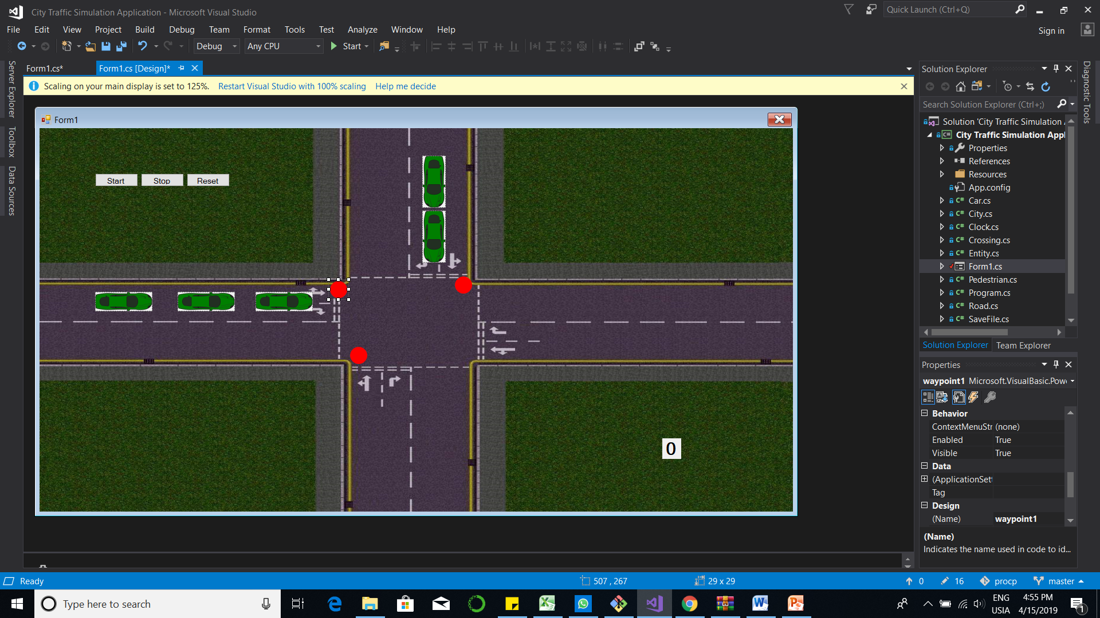
Process: Iteration 1

Slide 8
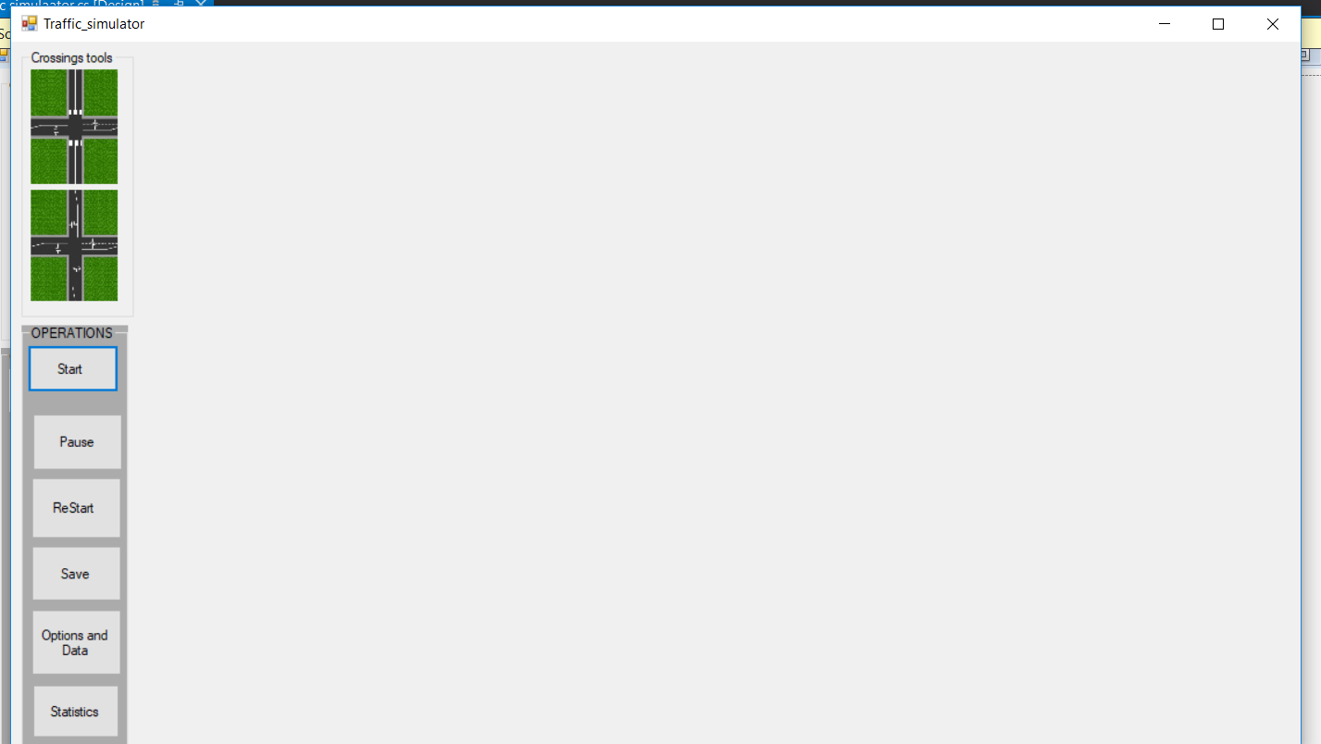
Process: Iteration 3

Slide 9
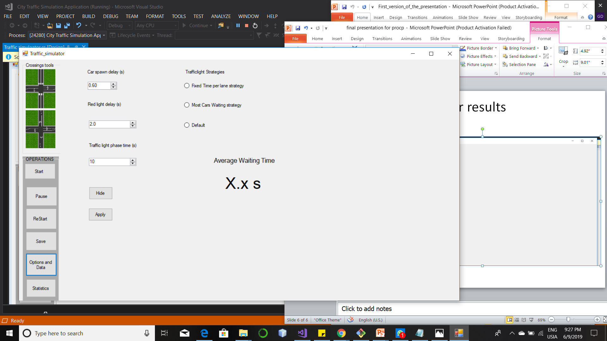
The options

Slide 10
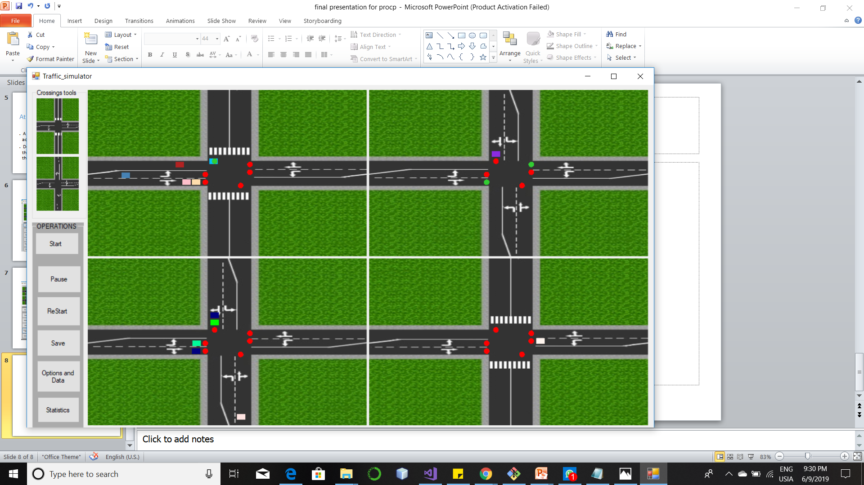
Running simulation

Slide 11
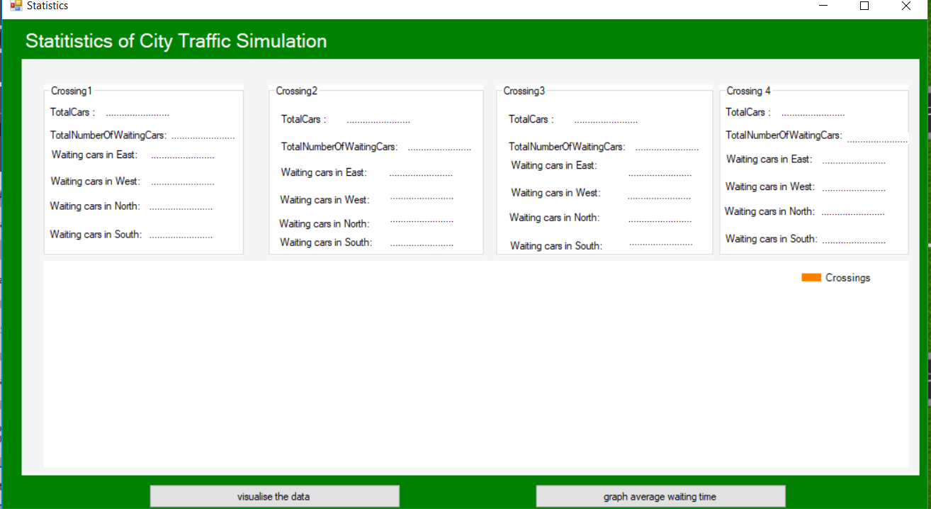
Statistics

Slide 12
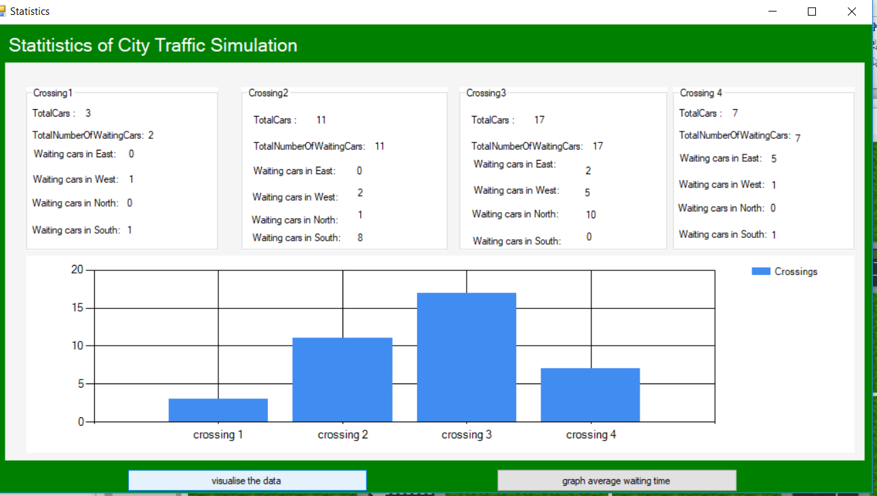
Visualization of statistics

Slide 13
Reflection (Our opinion about our result)
Our opinion about the application
Usability,
Maintainable
Extendable
Our ups for this project
Good team collaboration
Good coaching from our Mentor.
Our downs for the projects
Lack of time
Long period of time to understand each other

Slide 14
Demo Application
See working version of the application.

Slide 15

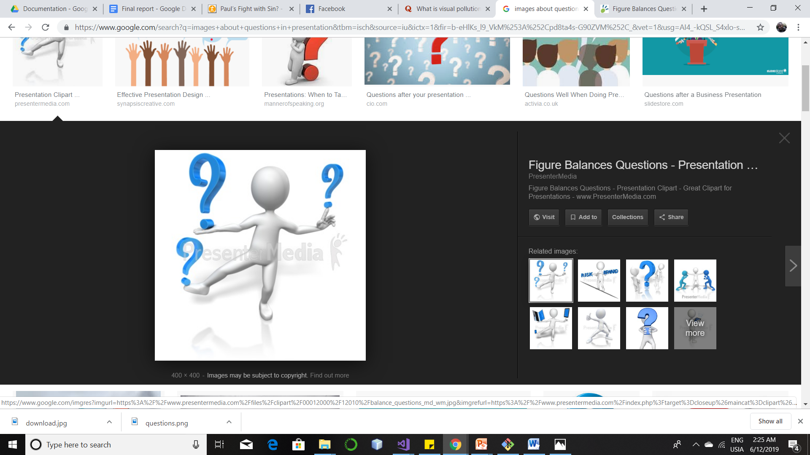
Conclusion

